Slide 1
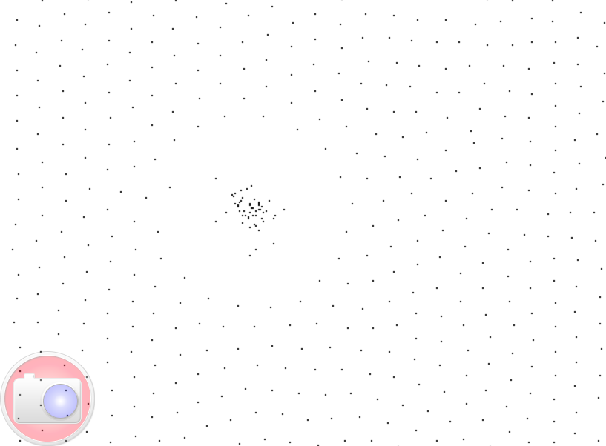
At the center
X = 0,486
Y = 0,258

